Slide 1
Nuclear Model

Slide 2
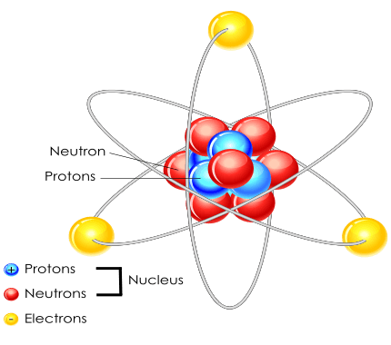
In this Smart Lesson you will learn to:
Outline the history of the nuclear model.
Describe the nuclear model of the atom characterised by a small nucleus surrounded by electrons.
Explain why protons in the nucleus repel each other.

Slide 3
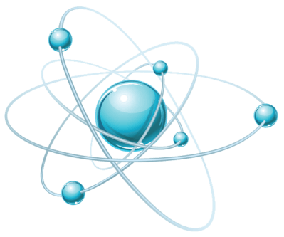
Atoms are the incredibly tiny particles that everything is made of!
Atoms are so small that you can't see them without a special microscope that uses electrons instead of light!

Slide 4
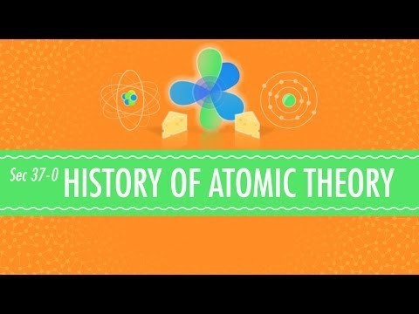

Slide 5
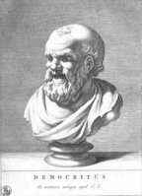
The current model of the atom has not been around forever!
Over 2000 years ago a Greek philosopher called Democritus hypothesised about dividing a material again and again until you cannot divide it any more. He called what remained an atomos, which is Greek for indivisible.

Slide 6
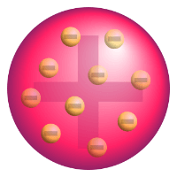
Models of atomic structure.
English chemist John Dalton proposed in 1803 that matter was composed of solid, indivisible spheres which cannot be destroyed. But what was the structure of the spheres?
The first widely accepted model of the atom was J. J. Thomson's model of the atom in 1904, shortly after the discovery of electrons. Thomson suggested that the electrons were randomly scattered within a positive matrix, like plums in a plum pudding. This earned the nickname the plum-pudding model.

Slide 7
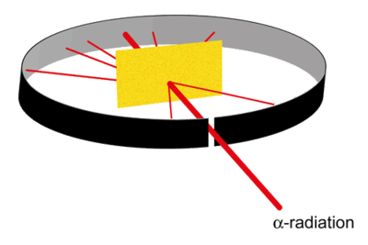
Experimental evidence led to a new theory.
A former student of J. J. Thomson, Ernest Rutherford disproved Thomson's model of the atom by firing α-radiation at an incredibly thin sheet of gold foil. If Thomson's model was true, then the radiation should have gone directly through with very little spread. Instead, Rutherford found that a small amount of radiation was deflected, and an even smaller amount bounced completely back.

Slide 8
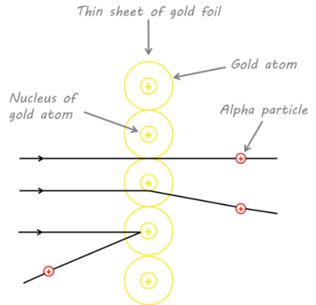
Rutherford's observations suggested two things:
1. | All the mass and positive charge are found in a small portion of the atom, as it takes a very dense positive mass to deflect the fast moving α-radiation particles. He called this the nucleus.
2. | Most of an atom is empty space, since the path for most of the α-radiation particles was unaffected.

Slide 9
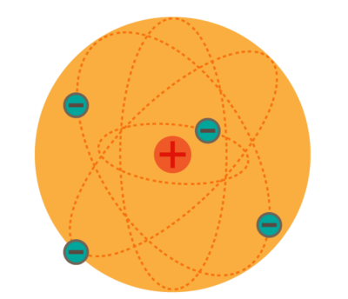
Rutherford believed that the electrons orbited this newly discovered nucleus, like planets around a sun.

Slide 10
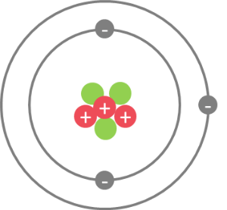
Niels Bohr's model of the atom.
Niels Bohr provided the next piece to the model in 1913 by observing that electrons could only orbit stably at specific distances from the nucleus. We call these distances electron shells, each of which corresponds to electrons with a certain energy level.

Slide 11
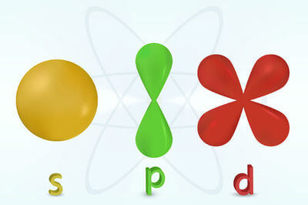
Quantum Mechanical Model.
As understanding of matter evolved, scientists realised waves could exhibit particle like properties and vice versa.
The Austrian scientist, Erwin Schrödinger treated electrons as waves and in 1926 proposed the Quantum Mechanical model of atomic structure. In this model there are orbitals which show where the electrons are likely to be 90% of the time! It shows the probability of an electron being within a given region of the atom.

Slide 12
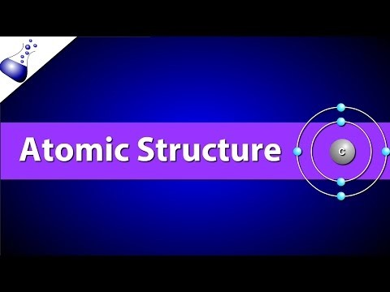

Slide 13
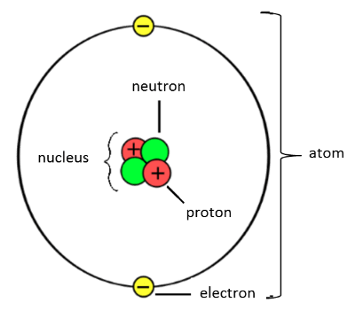
Atoms are made up of subatomic particles ("smaller than an atom" particles); these are protons, neutrons, and electrons.
The protons and neutrons make up the nucleus, which is at the centre of the atom. The electrons are found in orbitals (or shells) around the outside of the nucleus. The different orbitals are represented as circles at different distances from the nucleus because they have different energies.

Slide 14
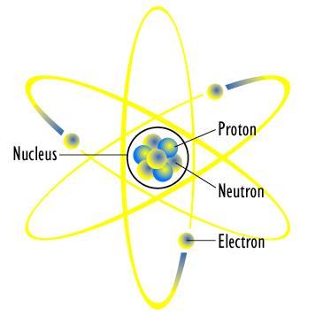
The different subatomic particles have different charges.
Protons are positively charged (+1); electrons are negatively charged (−1); and neutrons have no charge (0).
Protons and electrons have exactly opposite charges to each other. Opposite charges attract, and this is how the electrons are held in their shells outside of the nucleus. Neutrons have no charge, and they help prevent electrons and protons from crashing into each other and destroying the universe.

Slide 15

Why do protons repel each other?
Protons are positively charged (+1).
Like charges repel.
The neutrons act like glue and hold the nucleus together. The relative number of protons and neutrons is very important. If there are too few or too many neutrons compared to protons, the nucleus is unstable.

Slide 16
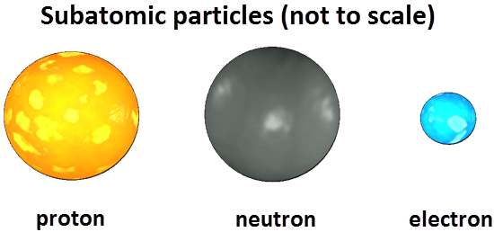
It is also important to look at the size of the subatomic particles.
Protons and neutrons each have a mass of 1.67×10⁻²⁴g. This is such a tiny number that a new unit of mass is used: the atomic mass unit (amu).
Protons and neutrons both have a mass of 1 amu.

Slide 17
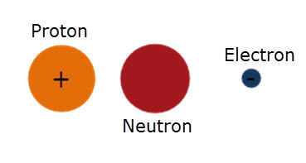
Electrons are 1840 times smaller than protons and neutrons.
They have a mass of 0.000549 amu. This is usually represented in terms of the relative mass, i.e. 1/1840 of the mass of protons and neutrons.

Slide 18
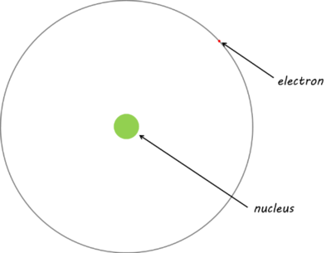
Electrons are also found a very long way from the nucleus, which means that most of an atom is empty space!
If the nucleus of a hydrogen atom were the size of a golf ball, then the electron would be the width of a human hair, and the distance between the two would be similar to the length of three rugby fields!

Slide 19
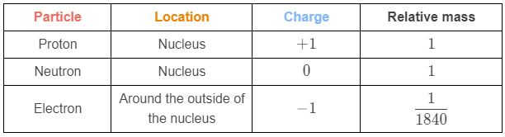
This table summarises the information you need to know about the subatomic particles:

